Slide 1
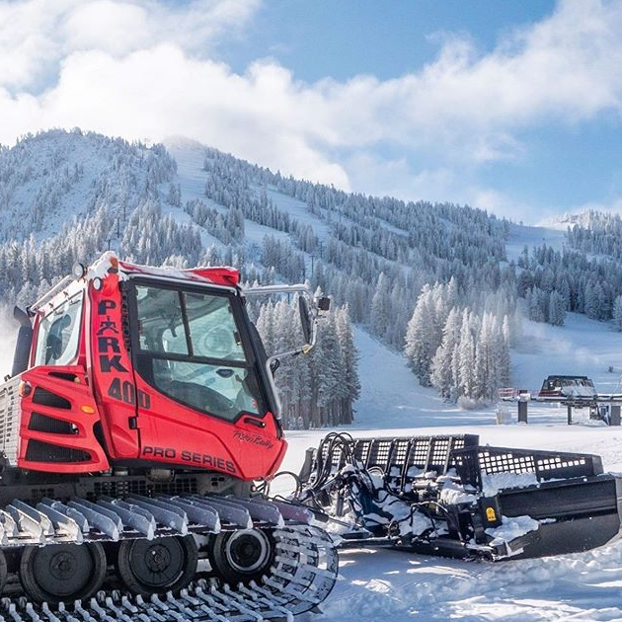
WSUP19-0020 (Mt. Rose Expansion)
Washoe County Board of Adjustment
December 5, 2019

Slide 2
Application Request
Request the approval of a Special Use Permit to allow for improvements to the Mt. Rose Ski Tahoe ski resort
The Special Use Permit includes:
  Replacing and expanding a maintenance building
  Building a first aid and ski patrol station
  Expanding the existing Winters Creek Lodge
  Repurposing several existing buildings
  Excavation of 9,900 cubic yards
    5,720 of it coming from the proposed Water Tank
  Disturbing an area of 3 acres
  8-year approval time frame

Slide 3
Location
Located on privately owned lands, and lands owned by the United States Forest Service
Located on 7 parcels
Main access to the site is 11.4 miles from the intersection of Mt. Rose Highway and Thomas Creek Road

Slide 4
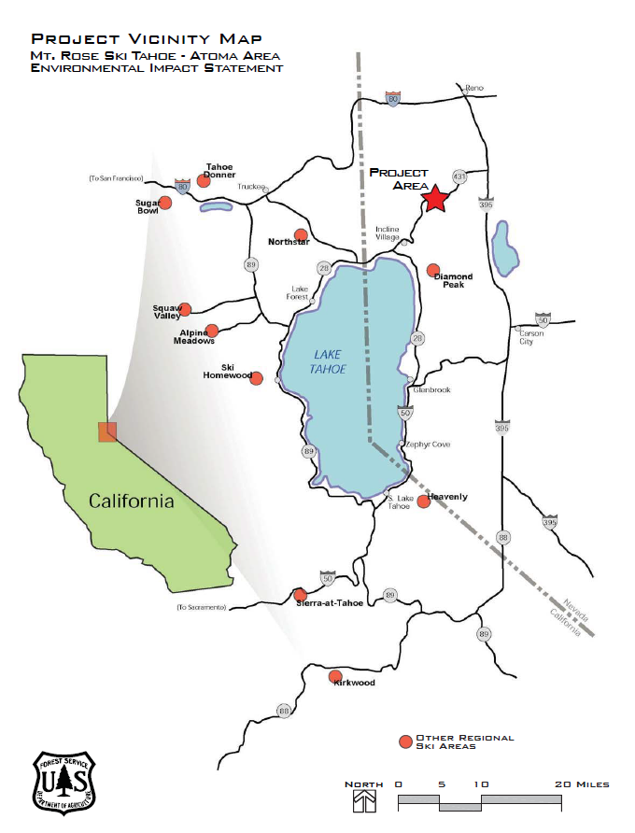
Vicinity Map

Slide 5
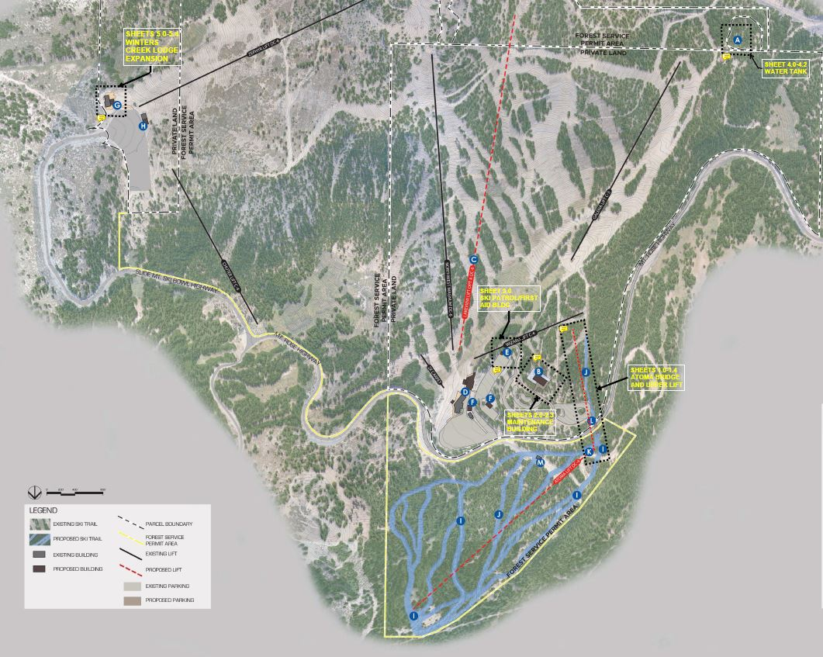
Overall Site Plan
U.S. Forest Service
Mt. Rose Development Co.
First Aid Location
Winters Creek Location
Maintenance Location

Slide 6
Environmental Impact Statement
Federal Review is being conducted by the USDA Forest Service.
NDOT is cooperating agency
Mt. Rose operates under a Special Use Permit administered by the Carson Ranger District

Slide 7
Environmental Impact Statement
Development proposals on public lands require a review of environmental impacts and alternatives.
In February of 2019, the final environmental impact statement (FEIS) and draft record of decision (ROD) were completed.
The final ROD should be issued in the next several months. The application does have support from the Forest Service.

Slide 8
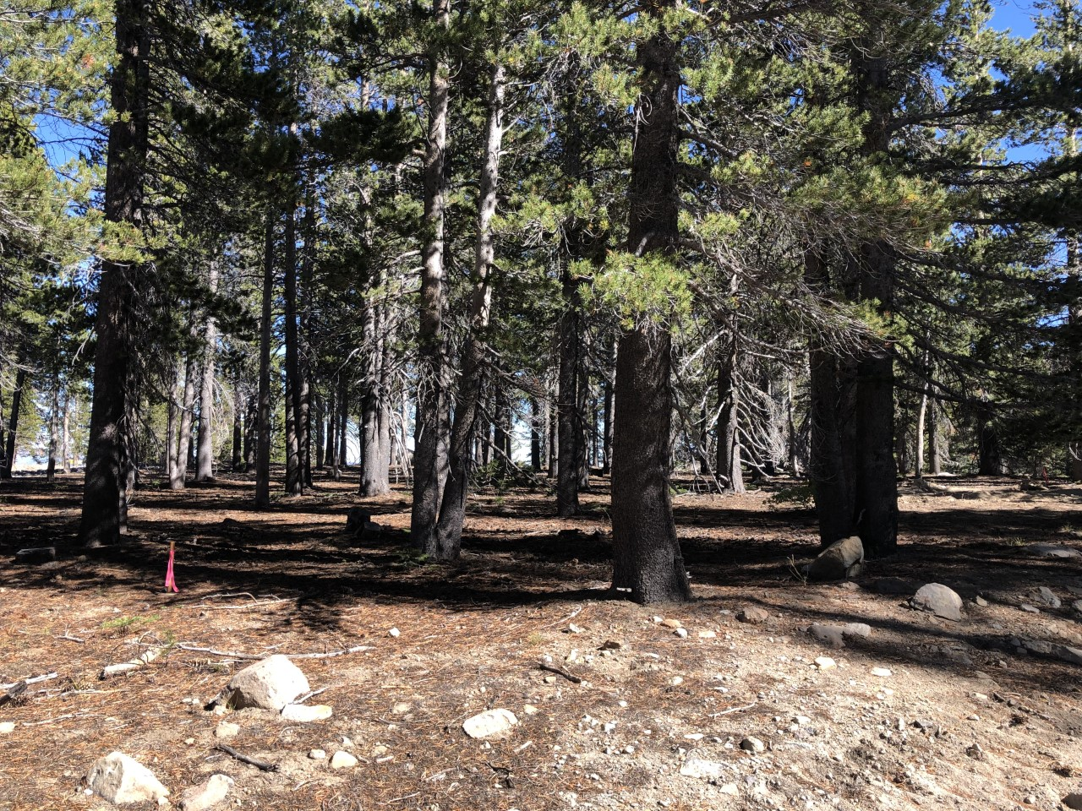
Location (Maintenance)

Slide 9
Maintenance Building
New Maintenance Building – 12,000 square feet
Intended to replace existing 5,000 square feet which was approved in 2012 under SB11-015
The maintenance building site location was chosen due to it having the least ground disturbance and was far enough from the existing power lines to not cause any conflict.

Slide 10
Varied Standards
110.438.45(a) Grading shall not result in slopes in excess of, or steeper than, three horizontal to one vertical (3:1)
110.438.45(c), Finish grading shall not vary from the natural slope by more than ten (10) feet in elevation
The applicant states that these varied standards are specifically to reduce scarring and land disturbance within this area. Staff supports varying these requirements for the maintenance building

Slide 11
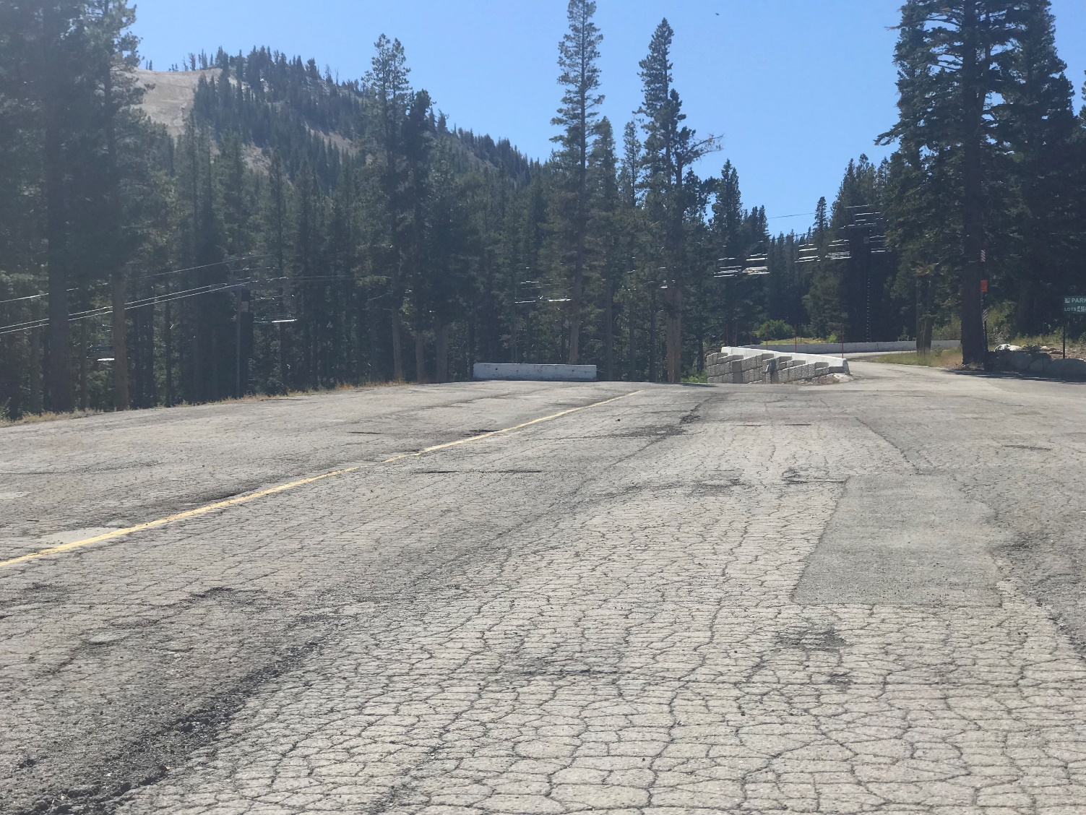
Location (First Aid)

Slide 12
First Aid Building
720 square foot first aid/ski patrol building
To be located on a previously paved area near the edge of the existing parking
Intended to replace the mobile first aid unit
Requesting to vary landscaping requirements
  Staff believes that ornamental landscaping would be inappropriate in this location

Slide 13
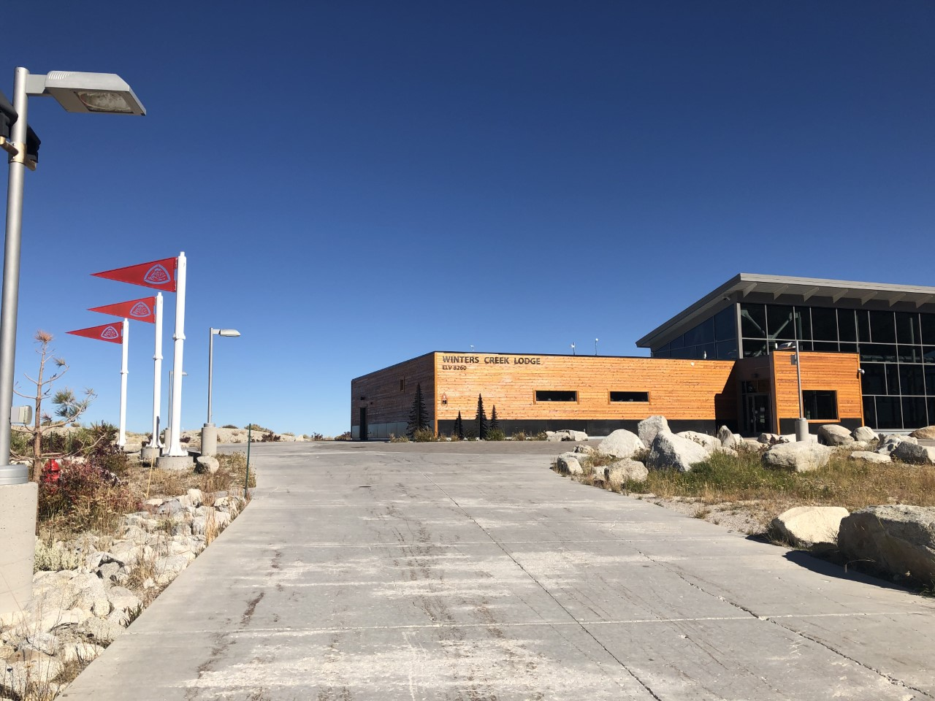
Winters Creek Lodge

Slide 14
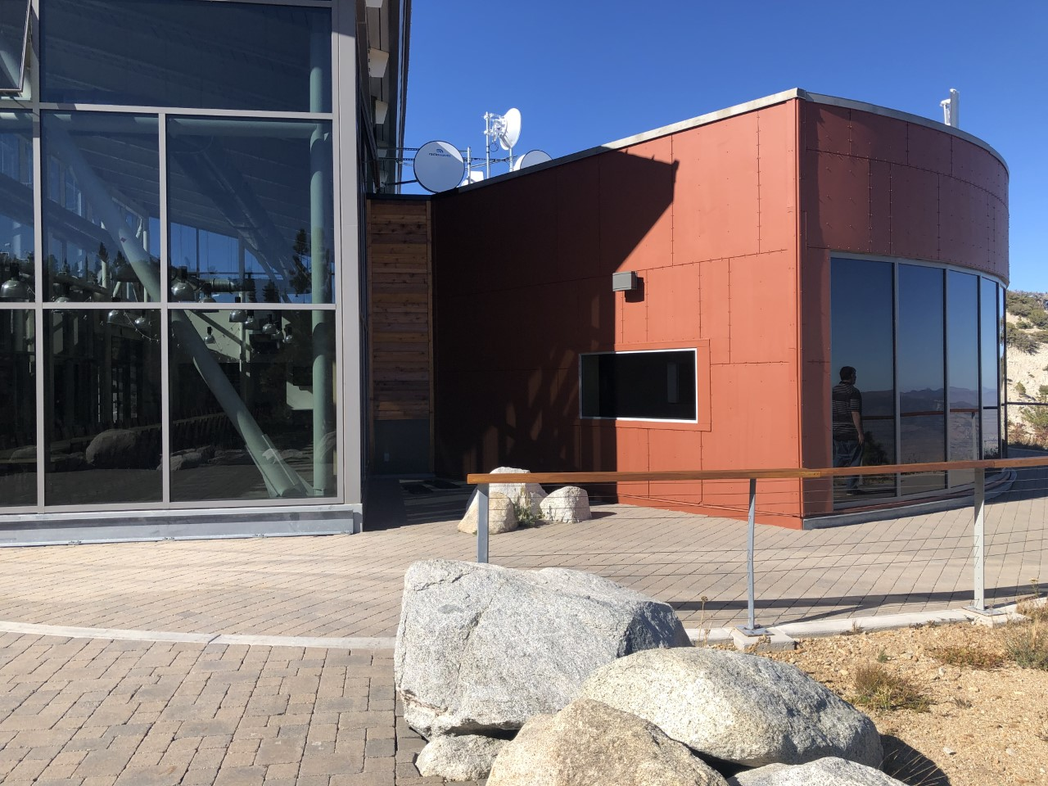
Winters Creek Lodge

Slide 15
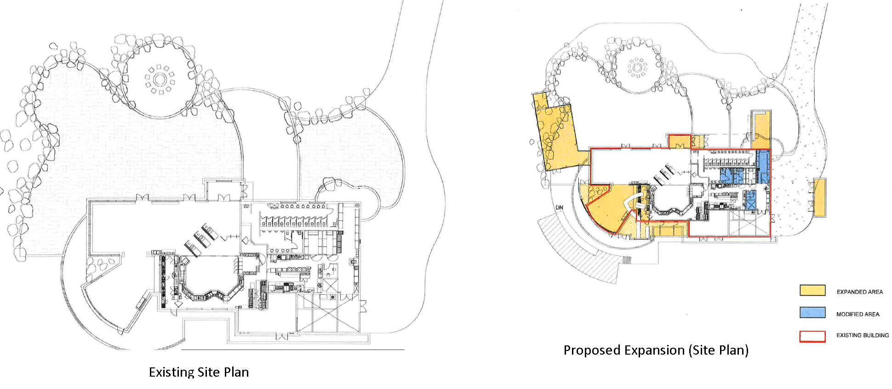
Winters Creek Lodge

Slide 16
Winters Creek Lodge
Located on the Slide Mountain side of ski resort
Existing lodge is 7,980 square feet in size
Proposal intends to expand the lodge by 3,140 square feet to a total area of 11,120 square feet.
Proposed outdoor deck extension
Existing ornamental landscaping that is to be disturbed during expansion will be replaced

Slide 17
Repurpose Existing Buildings
3 existing buildings to be repurposed
Existing vehicle maintenance to become employee lockers facility
Existing employee lockers facility to become a guest and passholder locker facility
Existing lift maintenance facility to become both employee and guest locker facility
These buildings are not being expanded

Slide 18
Public Notice & CAB
Notice sent to 42 affected property owners
This item was reviewed at the South Truckee Meadows/Washoe Valley CAB meeting on October 3, 2019. The CAB voted unanimously in support of the proposal.

Slide 19
Reviewing Agencies
Washoe County Community Services Dept.
Washoe County Health District
Washoe County Regional Animal Services
US Fish & Wildlife
US Forest Service
State of Nevada (Divisions of Environmental Protection, Forestry, Parks, State Lands, Water Resources, Transportation, and Wildlife)
Nevada State Historic Preservation Office
Truckee Meadows Fire Protection District
Regional Transportation Commission
Washoe-Storey Conservation District
Washoe County Sheriff

Slide 20
Forest Area Plan Findings
F.2.13—The approval of all special use permits and administrative permits must include a finding that the community character as described in the Character Statement can be adequately conserved through mitigation of any identified potential negative impacts.

Slide 21
Forest Area Plan Findings
F.12.3 The granting of special use permits in the Forest planning area must be accompanied by a finding that no significant degradation of air quality will occur as a result of the permit. As necessary, conditions may be placed on special use permits to ensure no significant degradation of air quality will occur. The Department of Community Development will seek the advice and input of the Air Quality Division of the Department of Health in the implementation of this policy.

Slide 22
Special Use Permit Findings
Consistency. That the proposed use is consistent with the action programs, policies, standards and maps of the Master Plan and the Forest Area Plan;
Improvements. That adequate utilities, roadway improvements, sanitation, water supply, drainage, and other necessary facilities have been provided, the proposed improvements are properly related to existing and proposed roadways, and an adequate public facilities determination has been made in accordance with Division Seven;
Site Suitability. That the site is physically suitable for a 5-million-gallon water tank, and for the intensity of such development;
Issuance Not Detrimental. That issuance of the permit will not be significantly detrimental to public health, safety or welfare; injurious to the property of improvements of adjacent properties; or detrimental to the character of the surrounding area;
Effect on a Military Installation. Issuance of the permit will not have a detrimental effect on the location, purpose of mission of the military installation.

Slide 23
Motion
I move that, after giving reasoned consideration to the information contained in the staff report and information received during the public hearing, the Washoe County Board of Adjustment approve with conditions Special Use Permit Case Number WSUP19-0021 for the Mt. Rose Development Company, to include varying WCC Section 110.412.40(a), Coverage, Civic and Commercial Use Types, Landscaping and WCC Section 110.438.45(a), Grading of Slopes, Grading Standards, and the modification to WCC Section 110.438.45(c), Grading of Slopes, Grading Standards, having made all five findings in accordance with Washoe County Code Section 110.810.30, and the two findings in accordance with the Forest Area Plan.

